Slide 1
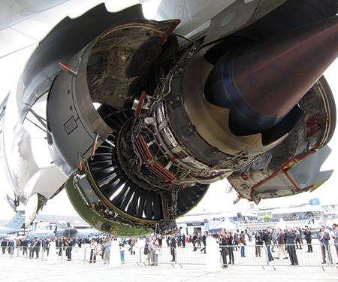
higher Design & Manufacture
Introduction to Materials

Slide 2
Learning intentions & success criteria
Learning Intentions
Developing an understanding of the properties and uses of materials.
Success Criteria
I can explain the importance of choosing the correct material for a product.

Slide 3
Choosing the right material
There are so many different types of materials available that selecting the most appropriate can be a time consuming task.
To avoid problems such as material failure it is worth considering;
Functional requirement
Manufacturing restrictions
Availability and cost of each material.

Slide 4
Properties
The prime consideration in all this is understanding the properties of the available materials.
Mechanical- ability to resist and support force eg. Streght, Toughness, Ductility (Stretching, bending etc.)
Physical- size, density and surface texture.
Thermal- withstand temperature change.
Chemical - how a material will react to corrosion/chemicals.
Electrical - how a material conducts or resists electrical currents.
Optical - ability to transmit and refract light.
Acoustical - ability to absorb and transfer sound.

Slide 5
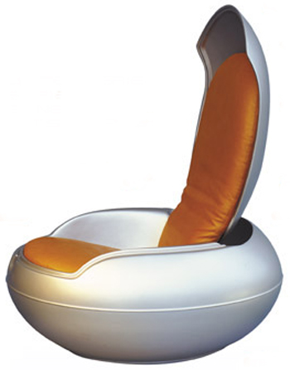
Implications
Before choosing the material a few questions must be considered:
What is the material?
Is the material suited to the expected tasks it is likely to perform?
Does it meet the specification for the new product?
How will sunlight and other external elements affect the material?
What are the properties of the material?
What does it cost?
What other material could do the same job?
How much will that cost?
The principal objective here is to find ways in which a particular function can be achieved at a reduced cost by substituting an alternative material.

Slide 6
The systematic approach
Choosing materials depends on:
Properties
Costs
Available Resources
Number to be produced
Product Complexity
Effect on the Environment
Design requirements
Social Factors
Service requirements
Each one of these headings should generate discussion, testing and research.

